Slide 1
Chapter 9: GRAVITY

Slide 2
This lecture will help you understand:
The Newtonian Synthesis
The Universal Law of Gravity
The Universal Gravitational Constant
Gravity and Distance : Inverse-Square Law
Weight and Weightlessness
Ocean Tides
Gravitational Fields
Einstein’s Theory of Gravitation
Black Holes
Universal Gravitation

Slide 3
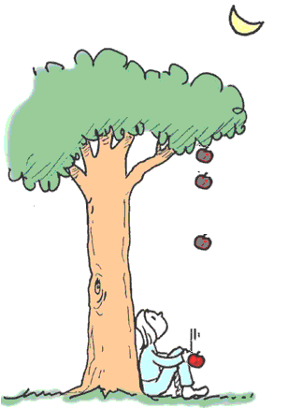
The Newtonian Synthesis
Newton was not the first to discover gravity. Newton discovered that gravity is universal.
Legend—Newton, sitting
under an apple tree, realizes that the Earth’s pull on an apple extends also to pull on the Moon.

Slide 4
The Falling Apple
Newton saw the apple fall, or maybe even felt it fall on his head. Perhaps he looked up through the apple tree branches and noticed the moon.
  He may have been puzzled by the fact that the moon does not follow a straight-line path, but instead circles about Earth.
  He knew that circular motion is accelerated motion, which requires a force.
  Newton had the insight to see that the moon is falling toward Earth, just as the apple is.

Slide 5
The Falling Moon
Newton’s Hypothesis
Newton compared motion of the moon to a cannonball fired from the top of a high mountain.
  If a cannonball were fired with a small horizontal speed, it would follow a parabolic path and soon hit Earth below.
  Fired faster, its path would be less curved and it would hit Earth farther away.
  If the cannonball were fired fast enough, its path would become a circle and the cannonball would circle indefinitely.

Slide 6
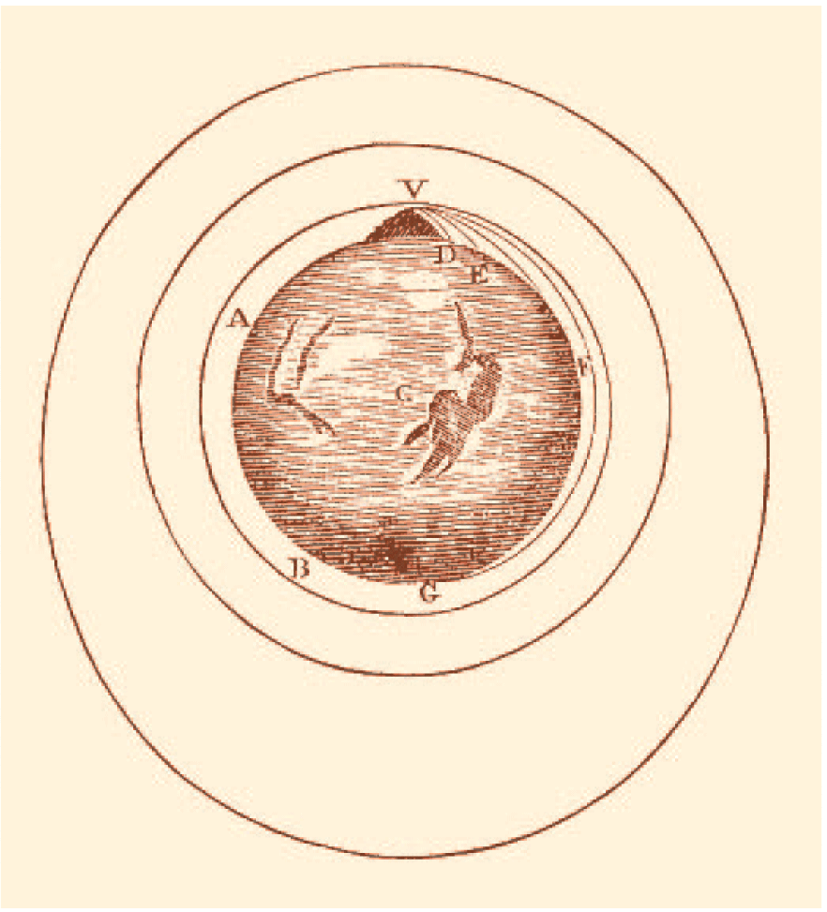
The Falling Moon
This original drawing by Isaac Newton shows how a projectile fired fast enough would fall around Earth and become an Earth satellite.

Slide 7
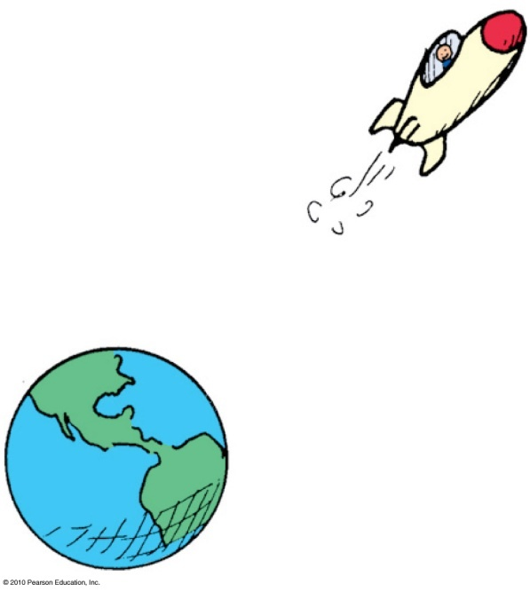
The Universal Law of Gravity
Law of universal gravitation:
Everything pulls on everything else.
Every body attracts every other body with a force that is directly proportional to the product of their masses and inversely proportional to the square of the distance separating them.

Slide 8
The Universal Law of Gravity
In equation form:
where m is the mass of the objects and d is the distance between their centers.
Examples:
    The greater the masses m₁ and m₂ of two bodies, the greater the force of attraction between them.
    The greater the distance of separation d, the weaker the force of attraction.
mass
×
mass
m
m
Force
~
₁
₂
or
F
~
₁
₂
distance
d
²
²

Slide 9
Newton’s most celebrated synthesis was and is of
The Universal Law of Gravity
CHECK YOUR NEIGHBOR
A. earthly and heavenly laws.
weight on Earth and weightlessness in outer space.
masses and distances.
the paths of tossed rocks and the paths of satellites.
Notes:
A. earthly and heavenly laws.

Slide 10
Newton’s most celebrated synthesis was and is of
The Universal Law of Gravity
CHECK YOUR ANSWER
A. earthly and heavenly laws.
weight on Earth and weightlessness in outer space.
masses and distances.
the paths of tossed rocks and the paths of satellites.
Comment:
This synthesis provided hope that other natural phenomena followed universal laws and ushered in the “Age of Enlightenment.”
Notes:
A. earthly and heavenly laws.

Slide 11
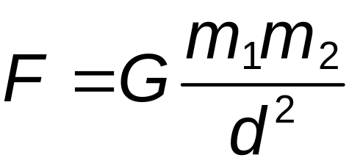
The Universal Gravitational Constant, G
Gravity is the weakest of four known fundamental forces
With the gravitational constant G, we have the equation
Universal gravitational constant:
G = 6.67 × 10⁻¹¹ Nm²/kg²
Once the value was known, the mass of Earth was calculated as 6 × 10²⁴ kg

Slide 12
The universal gravitational constant, G, which links force to mass and distance, is similar to the familiar constant
The Universal Gravitational Constant, G
CHECK YOUR NEIGHBOR
A. π.
g.
acceleration due to gravity.
speed of uniform motion.
Notes:
A. π.

Slide 13
The universal gravitational constant, G, which links force to mass and distance, is similar to the familiar constant
The Universal Gravitational Constant, G
CHECK YOUR ANSWER
A. π.
g.
acceleration due to gravity.
speed of uniform motion.
Explanation:
Just as π relates the circumference of a circle to its diameter, G relates force to mass and distance.
Notes:
A. π.

Slide 14
Gravity and Distance: The Inverse-Square Law
Inverse-square law:
relates the intensity of an effect to the inverse- square of the distance from the cause.
in equation form: intensity = 1/distance².
for increases in distance, there are decreases in force.
even at great distances, force approaches but never reaches zero.

Slide 15
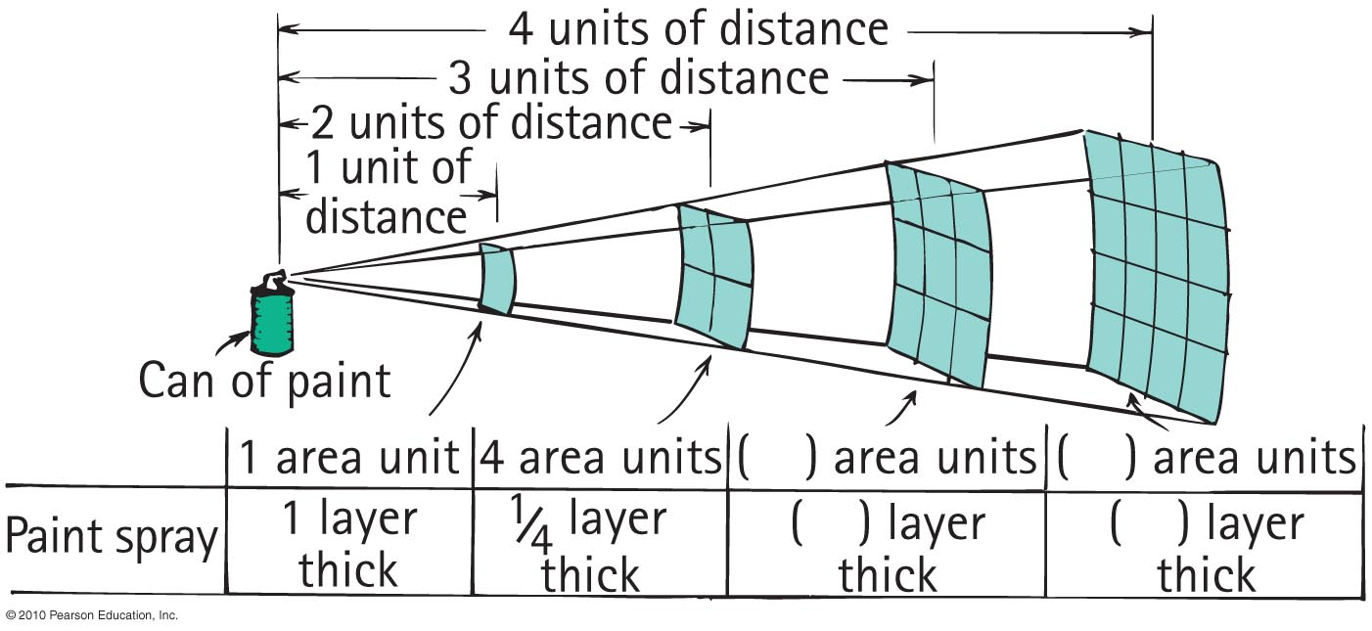
Inverse-Square Law

Slide 16
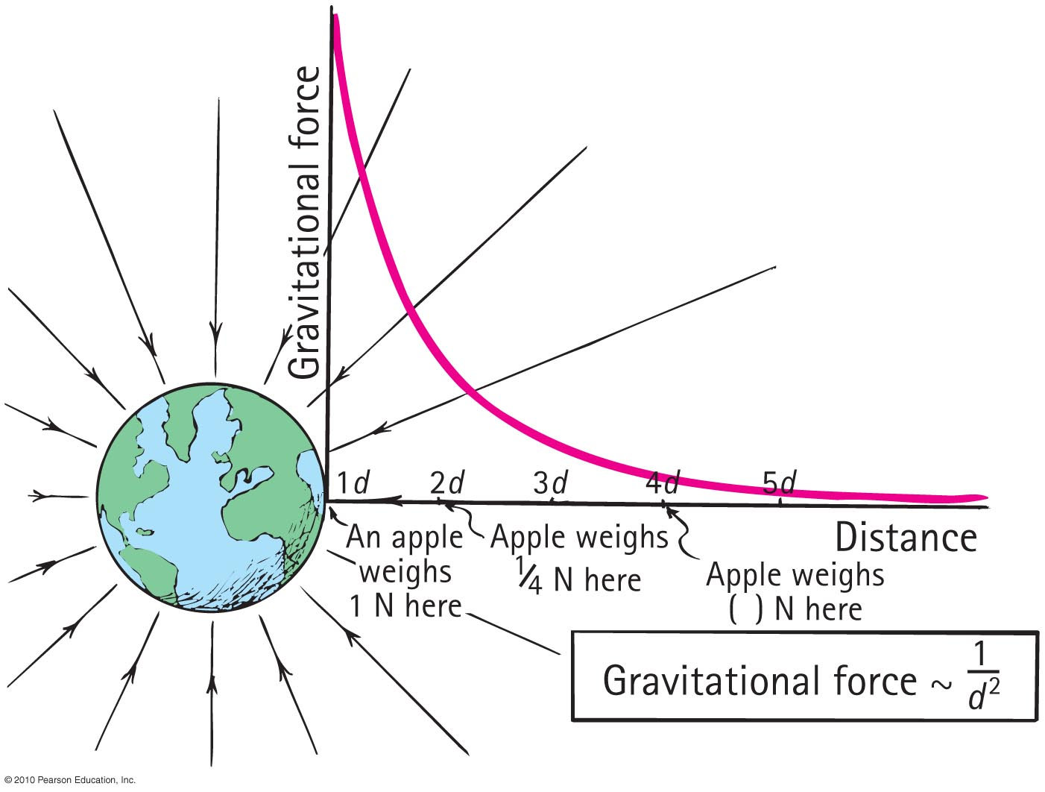
Inverse-Square Law

Slide 17
The force of gravity between two planets depends on their
Gravity and Distance: The Inverse-Square Law
CHECK YOUR NEIGHBOR
A. masses and distance apart.
planetary atmospheres.
rotational motions.
All of the above.
Notes:
A. masses and distance apart.

Slide 18
The force of gravity between two planets depends on their
Gravity and Distance: The Inverse-Square Law
CHECK YOUR ANSWER
A. masses and distance apart.
planetary atmospheres.
rotational motions.
All of the above.
Explanation:
The equation for gravitational force,
cites only masses and distances as
variables. Rotation and atmospheres
are irrelevant.
Notes:
A. masses and distance apart.

Slide 19
If the masses of two planets are each somehow doubled, the force of gravity between them
Gravity and Distance: The Inverse-Square Law
CHECK YOUR NEIGHBOR
A. doubles.
quadruples.
reduces by half.
reduces by one-quarter.
Notes:
B. quadruples.

Slide 20
If the masses of two planets are each somehow doubled, the force of gravity between them
Gravity and Distance: The Inverse-Square Law
CHECK YOUR ANSWER
A. doubles.
quadruples.
reduces by half.
reduces by one-quarter.
Explanation:
Note that both masses double. Then, double × double = quadruple.
Notes:
B. quadruples.

Slide 21
If the mass of one planet is somehow doubled, the force of gravity between it and a neighboring planet
Gravity and Distance: The Inverse-Square Law
CHECK YOUR NEIGHBOR
A. doubles.
quadruples
reduces by half.
reduces by one-quarter.
Notes:
A. doubles.

Slide 22
If the mass of one planet is somehow doubled, the force of gravity between it and a neighboring planet
Gravity and Distance: The Inverse-Square Law
CHECK YOUR ANSWER
A. doubles.
quadruples.
reduces by half.
reduces by one-quarter.
Explanation:
Let the equation guide your thinking:
Note that if one mass doubles, then
the force between them doubles.
Notes:
A. doubles.

Slide 23
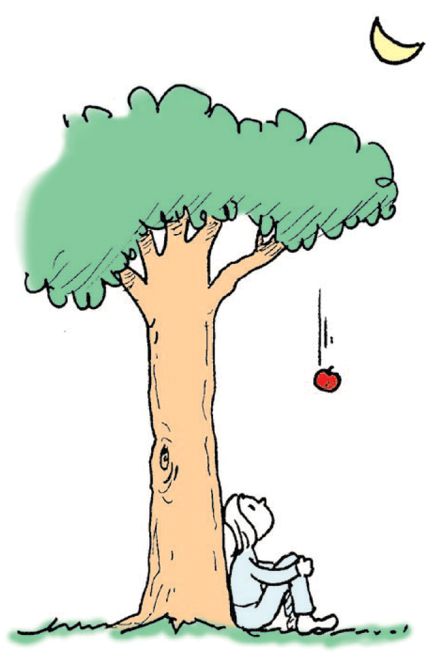
Gravity and Distance: The Inverse-Square Law
think!
Suppose that an apple at the top of a tree
is pulled by Earth’s gravity with a force of
1 N. If the tree were twice as tall, would the
force of gravity on the apple be only 1/4 as
strong? Explain your answer.

Slide 24
Gravity and Distance: The Inverse-Square Law
think!
Suppose that an apple at the top of a tree
is pulled by Earth’s gravity with a force of
1 N. If the tree were twice as tall, would the
force of gravity on the apple be only 1/4 as
strong? Explain your answer.
Answer:
No, the twice-as-tall apple tree is not twice as far from Earth’s center. The taller tree would have to have a height equal to the radius of Earth (6370 km) before the weight of the apple would reduce to 1/4 N.

Slide 25
Weight and Weightlessness
The force of gravity, like any force, causes acceleration.
Objects under the influence of gravity are pulled toward each other and accelerate.
We are almost always in contact with Earth, so we think of gravity as something that presses us against Earth rather than as something that accelerates us.

Slide 26
Weight and Weightlessness
Stand on a bathroom scale that is supported on a stationary floor. The gravitational force between you and Earth pulls you against the supporting floor and scale.
By Newton’s third law, the floor and scale in turn push upward on you.
Between you and the supporting floor is a spring-like gauge inside the bathroom scale.
This pair of forces compresses the gauge. The weight reading on the scale is linked to the amount of compression.

Slide 27
Weight and Weightlessness
Weight:
force an object exerts against a supporting surface
  Examples:
  standing on a scale in an elevator accelerating downward, less compression in scale springs; weight is less
  standing on a scale in an elevator accelerating upward, more compression in scale springs; weight is greater
  at constant speed in an elevator, no change in weight

Slide 28
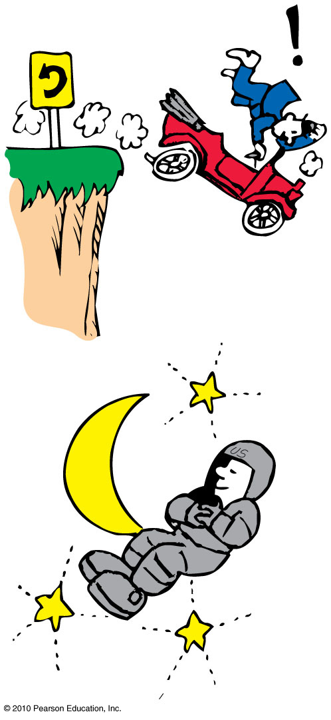
Weight and Weightlessness
Weightlessness:
no support force, as in free fall
  Example: Astronauts in orbit are without support forces and are in a continual state of weightlessness.

Slide 29
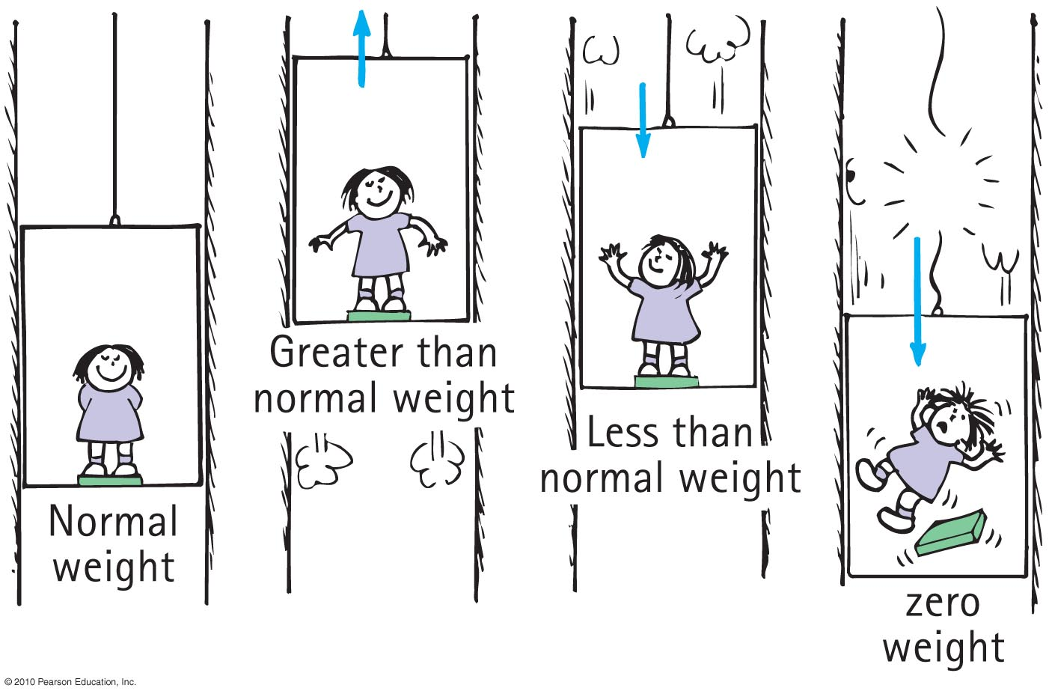
Weight and Weightlessness

Slide 30
When an elevator accelerates upward, your weight reading on a scale is
Weight and Weightlessness
CHECK YOUR NEIGHBOR
A. greater.
less.
zero.
the normal weight.
Notes:
A. greater.

Slide 31
When an elevator accelerates upward, your weight reading on a scale is
Weight and Weightlessness
CHECK YOUR ANSWER
A. greater.
less.
zero.
the normal weight.
Explanation:
The support force pressing on you is greater, so you weigh more.
Notes:
A. greater.

Slide 32
When an elevator accelerates downward, your weight reading is
Weight and Weightlessness
CHECK YOUR NEIGHBOR
A. greater.
less.
zero.
the normal weight.
Notes:
B. less.

Slide 33
When an elevator accelerates downward, your weight reading is
Weight and Weightlessness
CHECK YOUR ANSWER
A. greater.
less.
zero.
the normal weight.
Explanation:
The support force pressing on you is less, so you weigh less. Question: Would you weigh less in an elevator that moves downward at constant velocity?
Notes:
B. less.

Slide 34
When the elevator cable breaks, the elevator falls freely, so your weight reading is
Weight and Weightlessness
CHECK YOUR NEIGHBOR
A. greater.
less.
zero.
the normal weight.
Notes:
C. zero.

Slide 35
When the elevator cable breaks, the elevator falls freely, so your weight reading is
Weight and Weightlessness
CHECK YOUR ANSWER
A. greater.
less.
zero.
the normal weight.
Explanation:
There is still a downward gravitational force acting on you, but gravity is not felt as weight because there is no support force, so your weight is zero.
Notes:
C. zero.

Slide 36
If you weigh yourself in an elevator, you’ll weigh more when the elevator
Weight and Weightlessness
CHECK YOUR NEIGHBOR
A. moves upward.
moves downward.
accelerates upward.
All of the above.
Notes:
C. accelerates upward.

Slide 37
If you weigh yourself in an elevator, you’ll weigh more when the elevator
Weight and Weightlessness
CHECK YOUR ANSWER
A. moves upward.
moves downward.
accelerates upward.
All of the above.
Explanation:
The support provided by the floor of an elevator is the same whether the elevator is at rest or moving at constant velocity. Only accelerated motion affects weight.
Notes:
C. accelerates upward.

Slide 38
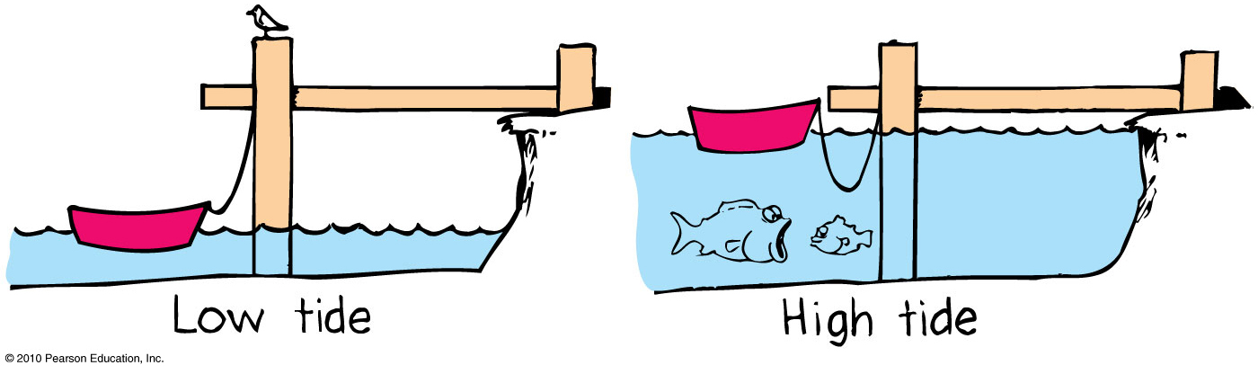
Ocean Tides
The differences between ocean levels at different times of the day are called tides.
There are typically two high tides and two low tides each day.

Slide 39
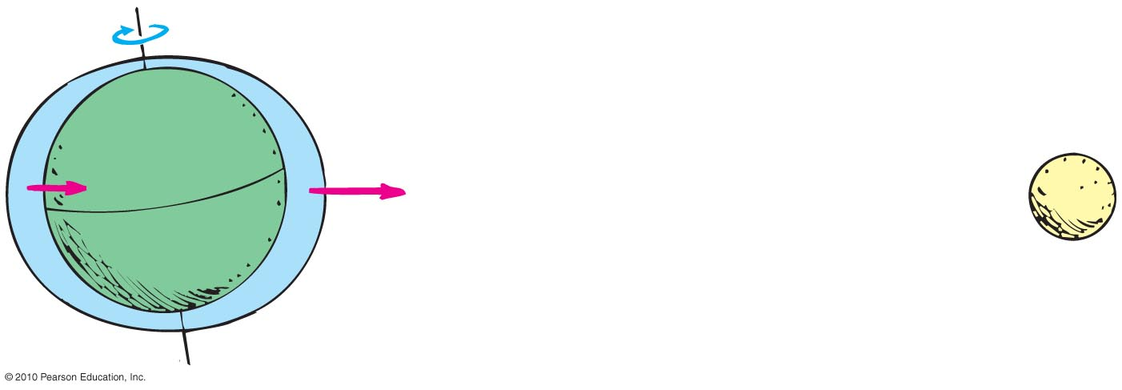
Ocean Tides
Ocean tides are caused due to the gravitational attraction of the Moon.
Unequal tugs on Earth’s oceans causes a stretching effect that produces a pair of ocean bulges.
  Because the two bulges are on opposite sides, high tides occur every 12 hours.

Slide 40
Ocean Tides
Factors Affecting Ocean Tides
The sun also contributes to ocean tides, about half as much as the moon.
Its pull on Earth is 180 times greater than the moon’s pull on Earth, so why aren’t solar tides 180 times greater than lunar tides?
The difference in gravitational pulls by the sun on opposite sides of Earth is very small.

Slide 41
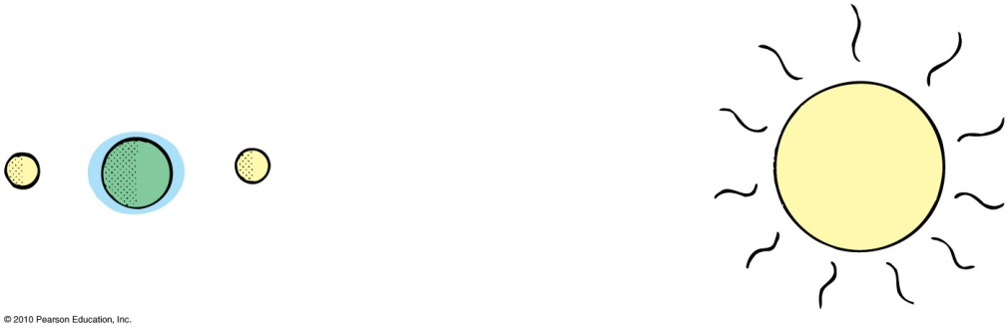
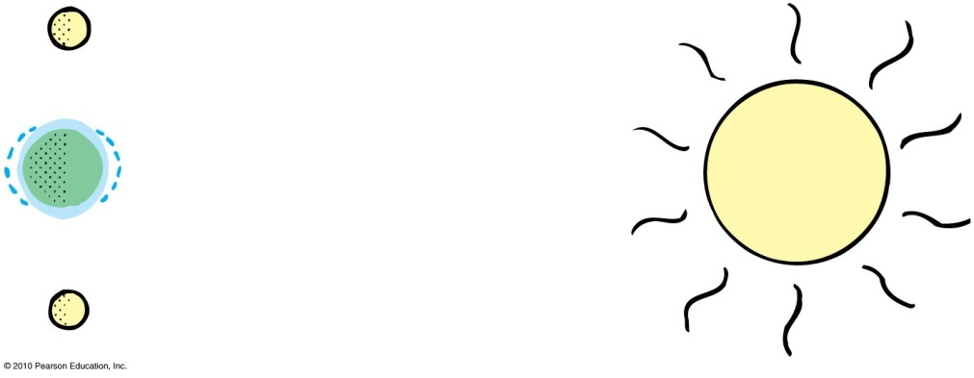
Ocean Tides
During the new Moon or full Moon, the effects of Moon and Sun add up, causing most pronounced spring tides.
When the Moon is halfway between a new and full Moon, the tides due to Sun and Moon partly cancel each other, causing least pronounced neap tides.

Slide 42
Gravitational Fields
Interaction between Earth and Moon is action at a distance. How do they interact without touching?
One way to think of this:
  Earth is surrounded by a gravitational field.
  Moon interacts with this gravitational field.
Gravitational field is an alteration of space around Earth (or any object with mass).
  Gravitational field is an example of a force field (another example: magnetic field).

Slide 43
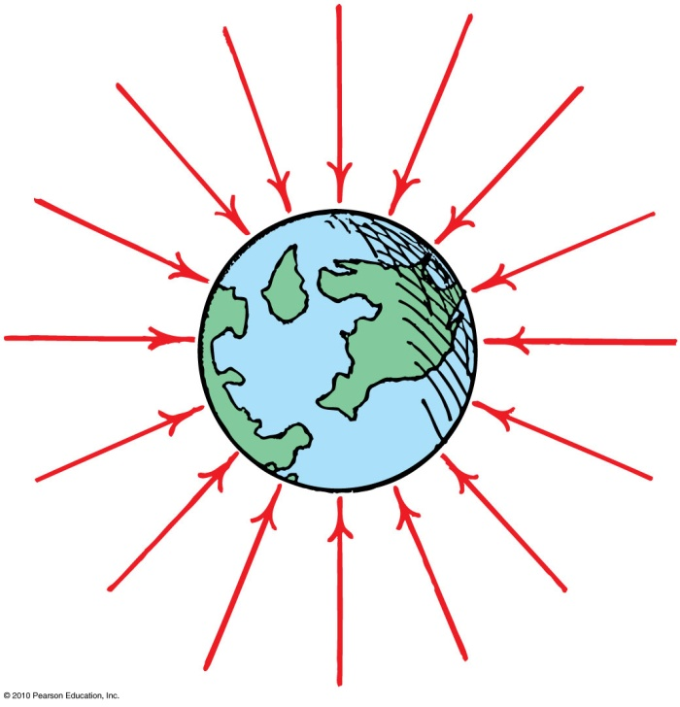
Gravitational Fields
Fields are represented by field lines radiating into the object (Earth).
The inward direction of arrows indicates that the force is always attractive to Earth.
The crowding of arrows closer to Earth indicates that the magnitude of the force is larger closer to Earth.

Slide 44
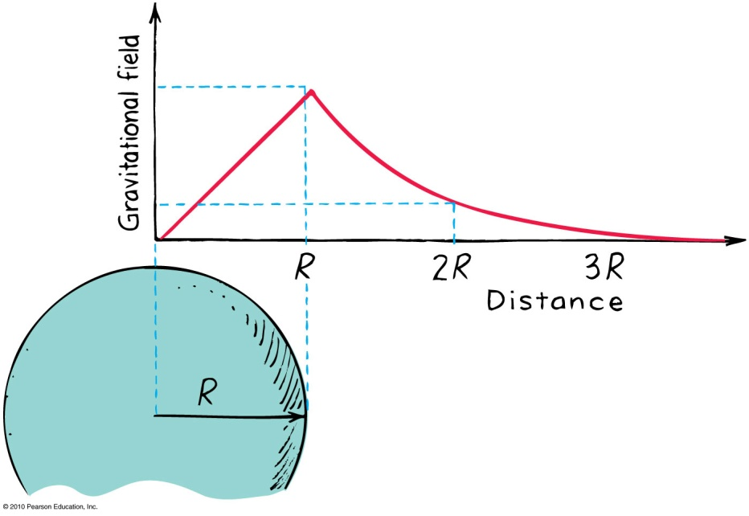
Gravitational Fields
Inside a planet, it decreases to zero at the center
  because pull from the mass of Earth below you is partly balanced by what is above you.
Outside a planet, it decreases to zero (not at the same rate as inside), at infinity
  because you are farther away from planet.

Slide 45
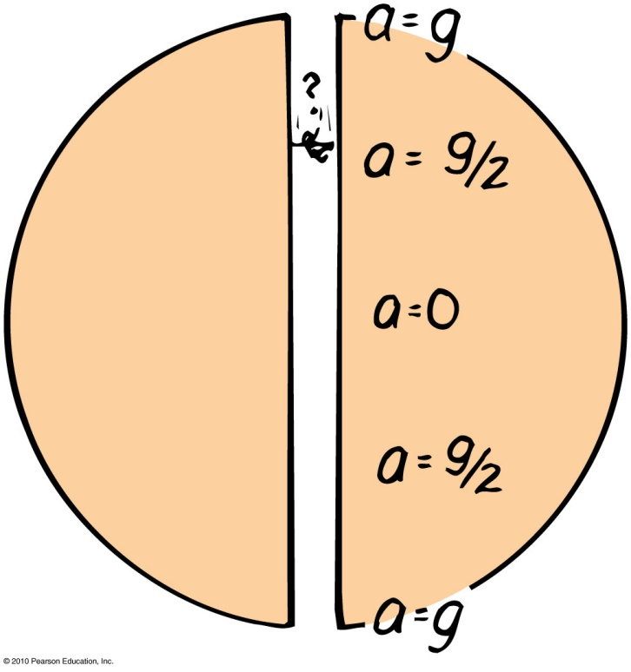
Gravitational Fields
Suppose you dig a hole through Earth to the other side and jump through it.
As you fall, your acceleration toward the center will go on decreasing.
At the center, your acceleration will be zero.
Past the center you will be pulled back up, but because you have acquired sufficient speed you will get to the other side.

Slide 46
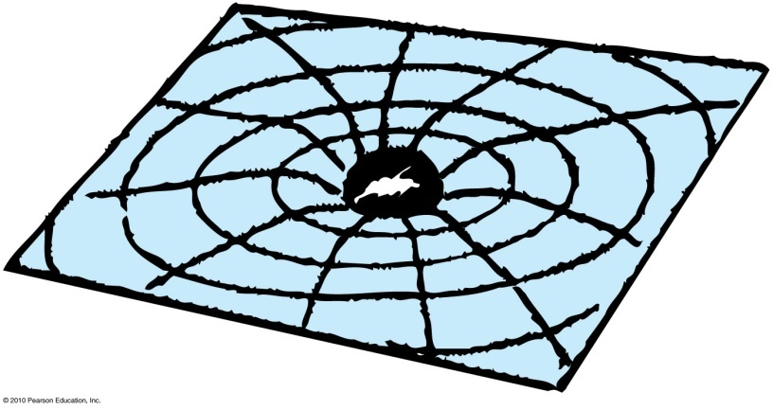
Einstein’s Theory of Gravitation
Gravitational field is a warping of space-time by a planet
  just as a massive ball would make a dent on the surface of a waterbed.
The warped space-time affects the motion of other objects
  just as a marble rolling on the waterbed “gravitates” to the dent.

Slide 47

Black Holes
When a massive star collapses into a black hole, there is no change in the gravitational field at any point beyond the original radius of the star.

Slide 48
Black Holes
Two main processes go on continuously in stars like our sun.
  Gravity tends to crush all solar material toward the center.
  Thermonuclear fusion, consisting of reactions similar to those in a hydrogen bomb, tends to blow solar material outward.
When the processes of gravity and thermonuclear fusion balance each other, the result is the sun of a given size.

Slide 49
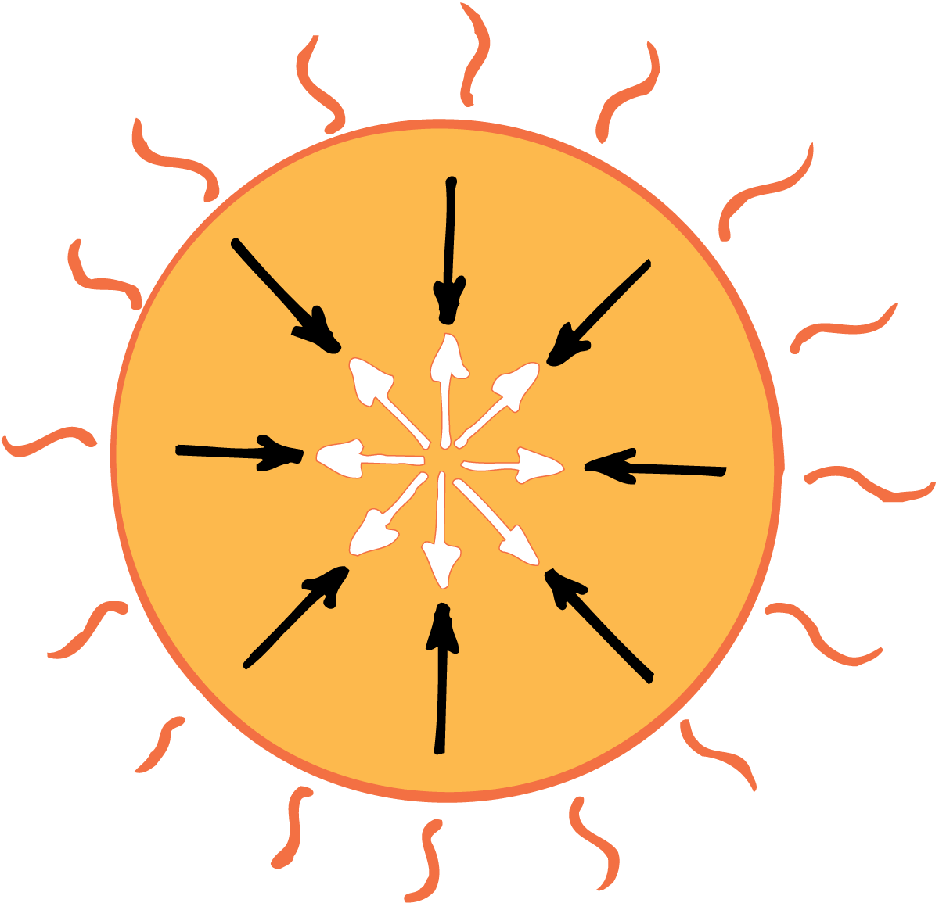
Black Holes
The size of the sun is the result of a “tug of war” between two opposing processes: nuclear fusion and gravitational contraction.

Slide 50
Black Holes
Formation of Black Holes
If the fusion rate increases, the sun will get hotter and bigger.
If the fusion rate decreases, the sun will get cooler and smaller.
When the sun runs out of fusion fuel (hydrogen), gravitation will dominate and the sun will start to collapse.

Slide 51
Black Holes
For a star that is at least two to three times more massive than our sun, once the flame of thermonuclear fusion is extinguished, gravitational collapse takes over—and it doesn’t stop!
The star caves in on itself and the atoms that compose the star cave in on themselves until there are no empty spaces.
The density becomes infinite near these black holes. Even light cannot escape a black hole.

Slide 52
Black Holes
Gravitational Field Near Black Holes
A black hole is no more massive than the star from which it collapsed.
The gravitational field near the black hole may be enormous but the field beyond the original radius of the star is no different after collapse than before.
The amount of mass has not changed, so there is no change in the field at any point beyond this distance.

Slide 53
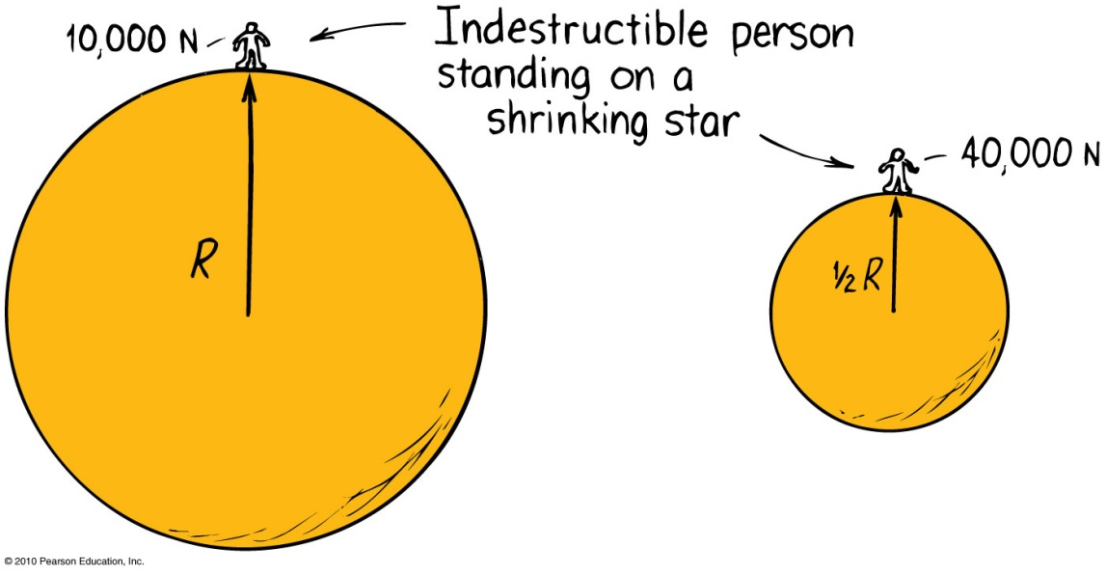
Black Holes
When a star shrinks, all of its mass is now concentrated in a smaller radius.
So gravitational force on the surface increases because
When d decreases, F increases.

Slide 54
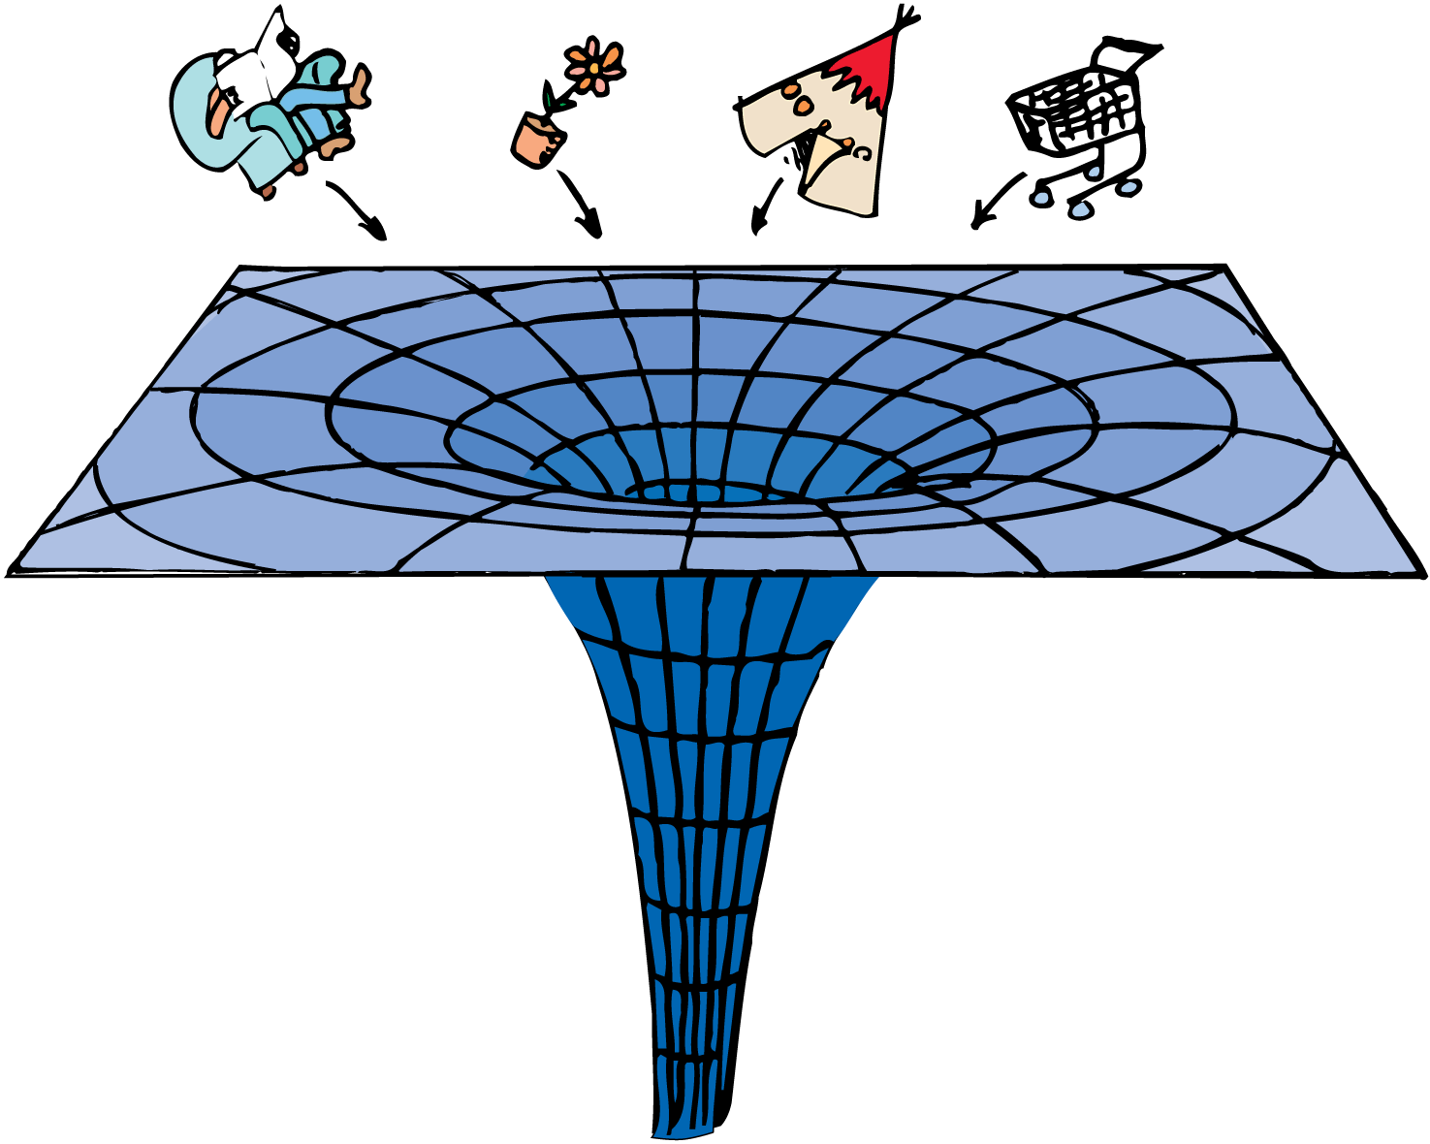
Black Holes
Black Hole: When the star becomes so small and the gravitational force at the surface becomes so large that even light cannot escape the surface,
  anything in its vicinity will be attracted by warped space-time and lost forever.

Slide 55
What would happen to Earth if the Sun became a black hole?
Black Holes
CHECK YOUR NEIGHBOR
A. It would break away from the attraction of the Sun.
It would be pulled into the Sun.
It would become a black hole too.
None of the above.
Notes:
D. None of the above.

Slide 56
What would happen to Earth if the Sun became a black hole?
Black Holes
CHECK YOUR ANSWER
A. It would break away from the attraction of the Sun.
It would be pulled into the Sun.
It would become a black hole too.
None of the above.
Explanation:
Letting the equation for gravity guide our thinking, we see that no mass changes, no distance from center to center changes, so there would be NO change in force between the shrunken Sun and Earth.
Notes:
D. None of the above.

Slide 57
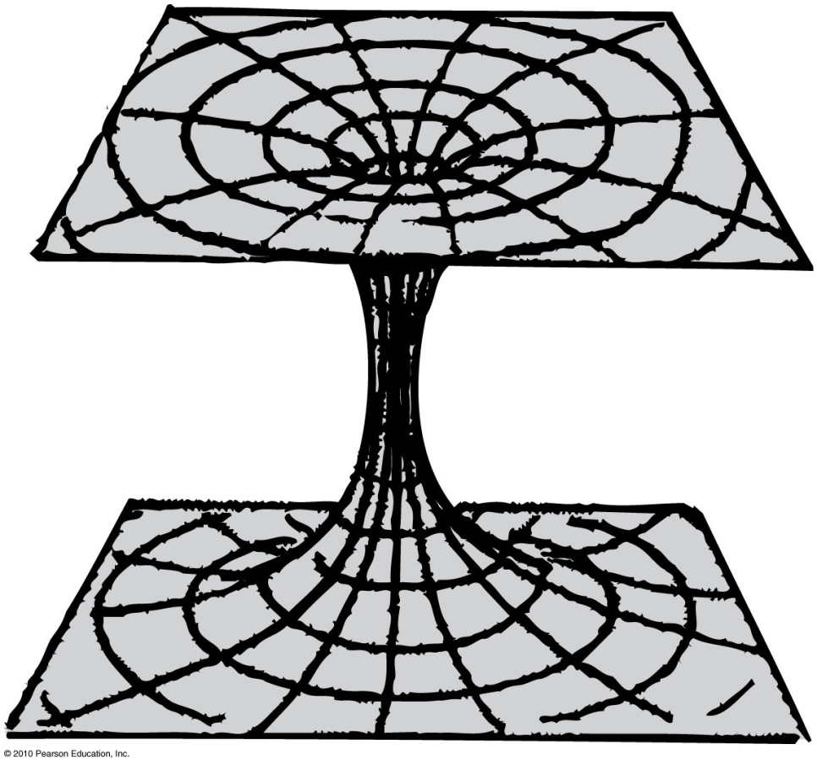
Wormhole
Wormhole: An enormous distortion of space-time,
  but instead of collapsing toward an infinitely dense point, the wormhole opens out again in some other part of the universe or different universe!
  No wormholes have been found yet.

Slide 58
Universal Gravitation
Universal gravitation
Everything attracts everything else.
Example: Earth is round because of gravitation—all parts of Earth have been pulled in, making the surface equidistant from the center.
The universe is expanding and accelerating outward.

Slide 59
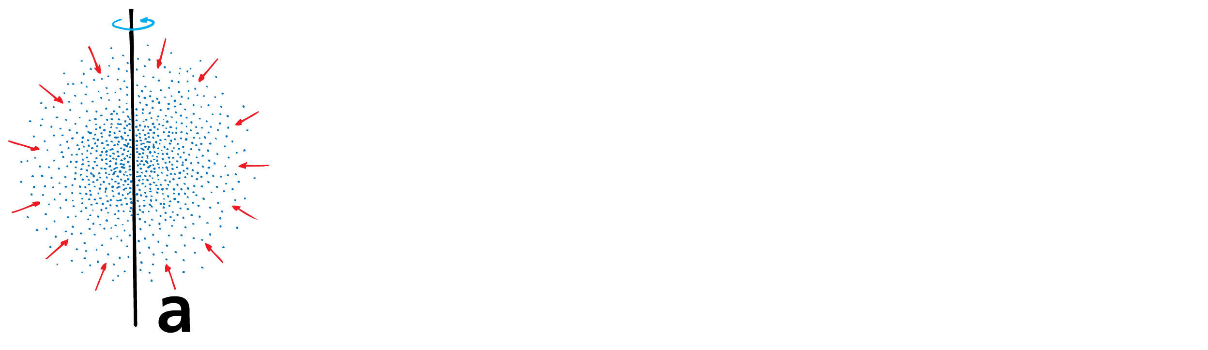
Universal Gravitation
Gravity played a role in the formation of the solar system.
A slightly rotating ball of interstellar gas contracted due to mutual gravitation.

Slide 60
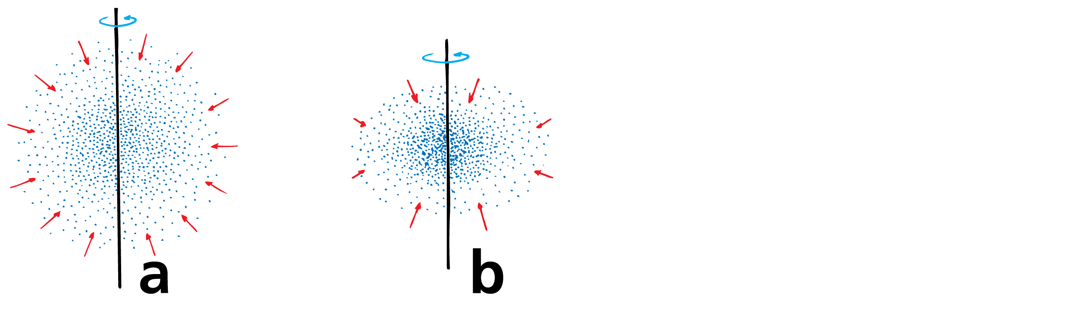
Universal Gravitation
Gravity played a role in the formation of the solar system.
A slightly rotating ball of interstellar gas contracted due to mutual gravitation.
To conserve angular momentum, the rotational speed of the ball of gas increased.

Slide 61
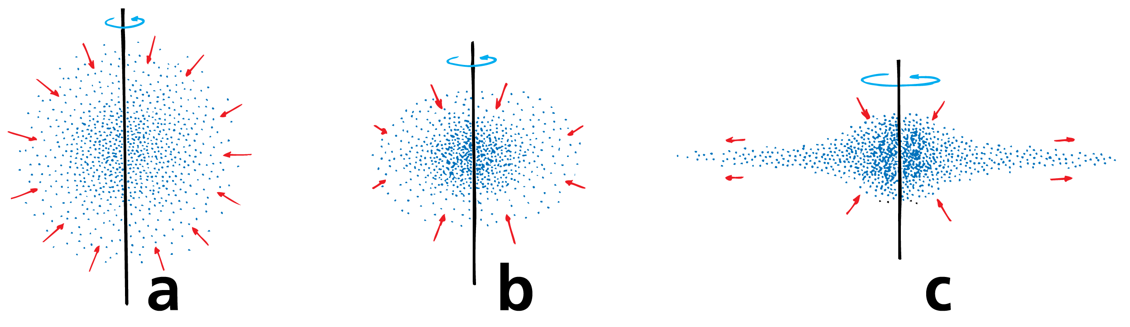
Universal Gravitation
Gravity played a role in the formation of the solar system.
A slightly rotating ball of interstellar gas contracted due to mutual gravitation.
To conserve angular momentum, the rotational speed of the ball of gas increased.
The increased momentum of the individual particles and clusters of particles caused them to sweep in wider paths about the rotational axis, producing an overall disk shape. The greater surface area of the disk promoted cooling and clusters of swirling matter—the birthplace of planets.

